Slide 1


Azure Kubernetes Service
Accelerate Growth on Cloud

Slide 2
Agenda
Kubectl
AKS Cluster Installation
Default Namespaces
Kubectl Installation and Pre-requisites
What is a POD
What is a Namespaces
What is Service

Slide 3
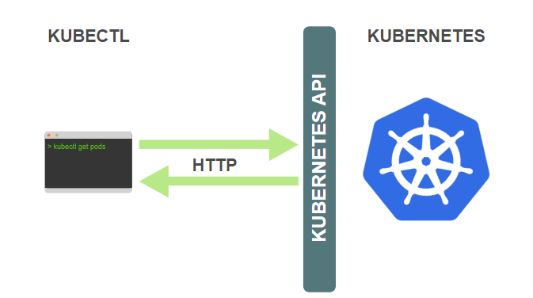
What is Kubectl
kubectl. The Kubernetes command-line tool, kubectl, allows you to run commands against Kubernetes clusters. You can use kubectl to deploy applications, inspect and manage cluster resources, and view logs.
Copyright (c) 2019. Blazeclan Technologies Pvt. Ltd.

Slide 4
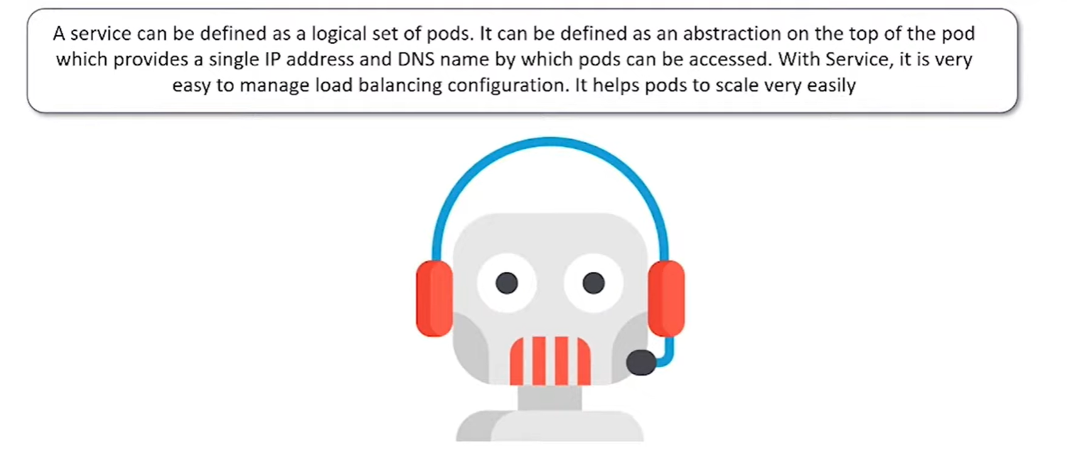
What is Service
Copyright (c) 2019. Blazeclan Technologies Pvt. Ltd.

Slide 5
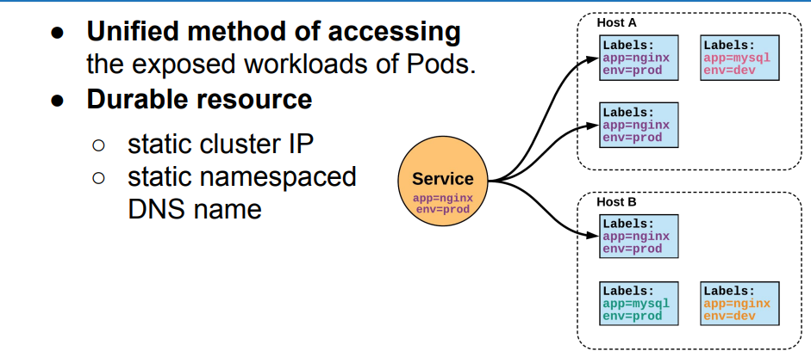
What is Service
Copyright (c) 2019. Blazeclan Technologies Pvt. Ltd.

Slide 6
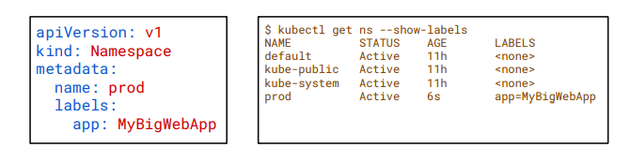
What is Namespace
Namespaces are a way to divide cluster resources among multiple users. Kubernetes Supports multiple virtual clusters backed by the same physical cluster. These Virtual clusters are called namespaces
Namespaces are a logical cluster or environment and are the primary method of partitioning a cluster or scoping access.
Copyright (c) 2019. Blazeclan Technologies Pvt. Ltd.

Slide 7
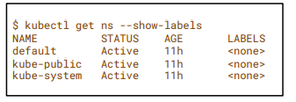
Default Namespaces
default: The default namespace for any object without a namespace.
kube-system: Acts as the home for objects and resources created by Kubernetes itself.
kube-public: A special namespace; readable by all users that is reserved for cluster bootstrapping and configuration
Copyright (c) 2019. Blazeclan Technologies Pvt. Ltd.

Slide 8
DEMO on KUBECTL Installation
Copyright (c) 2019. Blazeclan Technologies Pvt. Ltd.

Slide 9
AKS Cluster Installation DEMO
Copyright (c) 2019. Blazeclan Technologies Pvt. Ltd.

Slide 10

thank you
Notes:
Do Not edit this Slide, This is Thank you in motion

